Slide 1
UNDERGRADUATE PROJECT DEFENCE
Design and Implementation of a Secure E-Learning Platform
A web-based marketplace for students, instructors, and administrators
Prepared by: [Your Full Name]
Index Number: [Your Index Number]
Computer Science Department, Kumasi Technical University
Supervisor: [Supervisor’s Name]
July 2026
Notes:
Good morning/afternoon, panel members. My project is titled “Design and Implementation of a Secure E-Learning Platform.”,It focuses on a web-based marketplace that connects students, instructors, and administrators in one controlled platform.

Slide 2
Background and Problem
Why the proposed platform was needed
What is happening
The problem
E-learning gives learners flexible access to skills and course materials.
Independent instructors need a reliable way to publish and earn from courses.
The African setting needs support for local payment options.
Many global platforms rely on payment methods that are not convenient for every local learner.
Open marketplaces can expose students to unreviewed course content.
A platform handling money needs strong security, clear access control, and traceable actions.
E-Learning Platform Project Defence
2
Notes:
The project is not simply about putting courses online. The problem is the lack of one accessible platform that combines local payment, proper course governance, and security.

Slide 3
Aim and Objectives
What the project set out to achieve
Aim: To design and implement a secure web-based e-learning marketplace with role-based course management, local payment, automated assessment, and transparent revenue sharing.
1
Separate student, instructor, and administrator privileges.
4
Support free/paid enrolment and automatic revenue sharing.
2
Support course creation, review, approval, and publication.
5
Provide timed quizzes, auto-grading, and progress tracking.
3
Protect accounts with secure authentication and auditing.
6
Evaluate the system through functional and security testing.
E-Learning Platform Project Defence
3
Notes:
The aim is broad, but the objectives made it measurable. The rest of the presentation shows how each objective was implemented and tested.

Slide 4
Proposed Solution
One platform, three roles, controlled access
Student
Instructor
Administrator
Browse approved courses
Enrol and learn
Take quizzes and track progress
Review and message
Apply for approval
Create courses and quizzes
Track learners and earnings
Request withdrawals
Approve instructors/courses
Manage users and reviews
Process withdrawals
Monitor audit logs
E-Learning Platform Project Defence
4
Notes:
The system is built around three roles. Permissions are not cosmetic. Every role is enforced in the server-side access controls.

Slide 5
System Architecture
Three-tier architecture with external services
External services
Paystack
payments
Application Tier
Next.js
Server Actions
API Routes
Middleware
Presentation Tier
Data Tier
Browser
React interface
PostgreSQL
via Prisma
Brevo
email
HTTPS
Prisma
Google
OAuth
Blob/file
storage
E-Learning Platform Project Defence
5
Notes:
The browser is the presentation tier. It never talks directly to the database. All business rules run in the Next.js application layer, and PostgreSQL stores the relational data. Paystack, email, Google sign-in, and file storage remain external services behind server-side calls.

Slide 6
Tools and Technologies
Chosen for security, maintainability, and low-cost deployment
Frontend
Next.js 16, React 19, TypeScript, Tailwind CSS
Backend
Server Actions, API Routes, Auth.js
Data
PostgreSQL and Prisma ORM
Security
bcrypt, role-based access, rate limiting, audit logs
Payments
Paystack test environment
Deployment
Vercel and managed PostgreSQL
E-Learning Platform Project Defence
6
Notes:
I selected a modern TypeScript stack because it allows the user interface, server logic, and validation to work together. PostgreSQL and transactions are particularly important because the system handles payments and enrolments.

Slide 7
Security and Reliability Controls
Controls implemented to protect users, content, and payments
✓
Role-based access
✓
Password protection
Students, instructors, and admins are restricted by middleware and server-side checks.
Passwords are hashed with bcrypt; inactive accounts cannot sign in.
✓
Rate limiting
✓
Safe payments
Database-backed limits resist repeated login, OTP, reset, and message abuse.
Server-side Paystack verification and idempotent payment completion prevent duplicate crediting.
✓
Quiz integrity
✓
Audit trail
HMAC-signed start token and a server-side time check protect timed attempts.
Sensitive actions are recorded for review and dispute handling.
E-Learning Platform Project Defence
7
Notes:
Security was not treated as an afterthought. The two controls I would emphasize under questions are the signed quiz session token and idempotent payment completion.

Slide 8
Course Approval and Paid Enrolment
The two workflows that make the marketplace governable
Course governance
Create course
Submit
for review
Admin
approves
Publish
Students
enrol
Paid enrolment
Student selects
paid course
Payment
created
Paystack
payment
Server verifies
transaction
Enrolment +
earnings update
Duplicate callbacks or webhooks are safe because payment completion runs once inside a conditional database transaction.
E-Learning Platform Project Defence
8
Notes:
Only an approved and published course reaches the public catalogue. For paid enrolment, the system does not trust the browser alone. It verifies the transaction server-side before granting access.

Slide 9
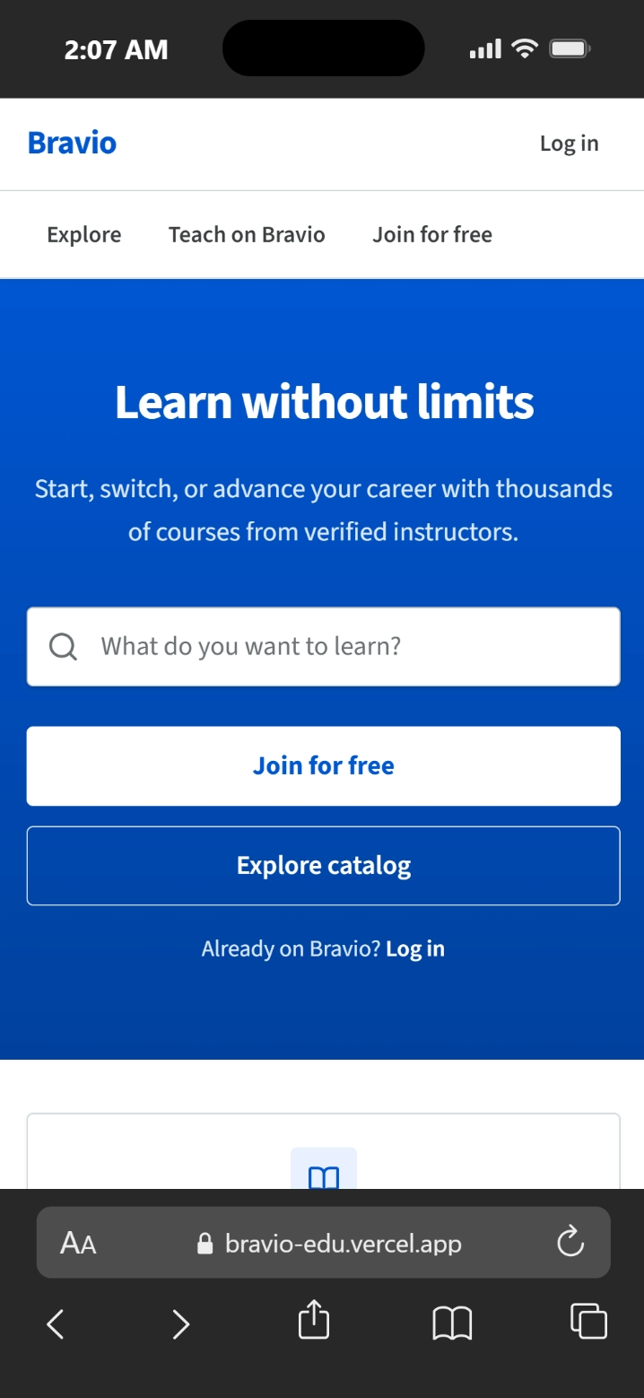
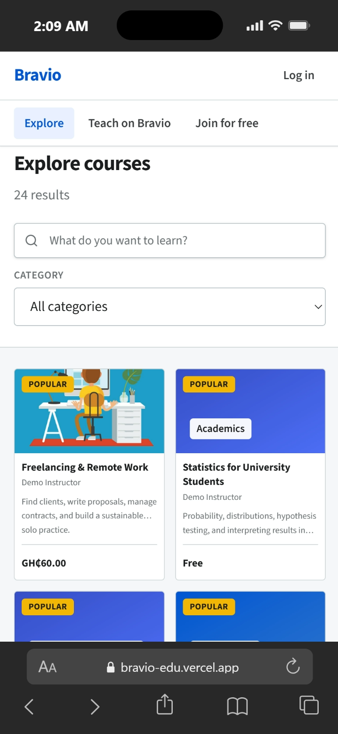
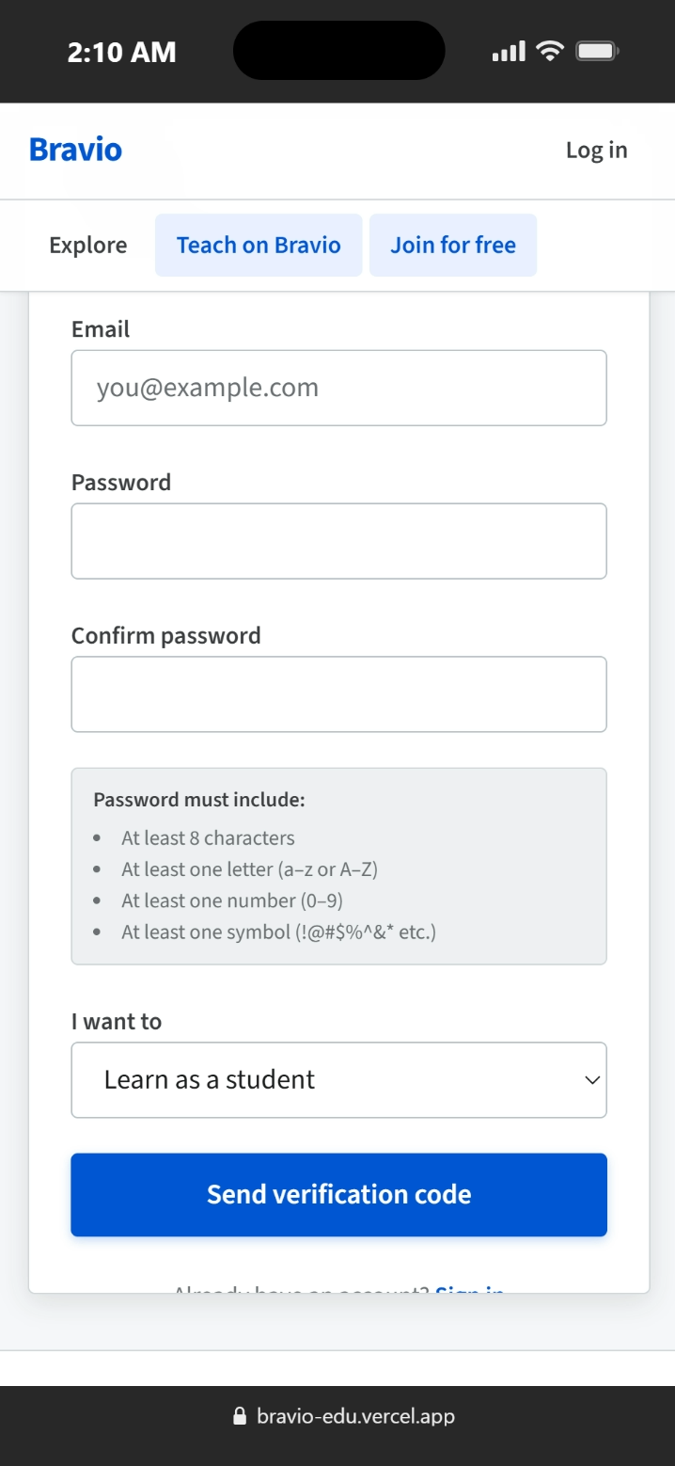
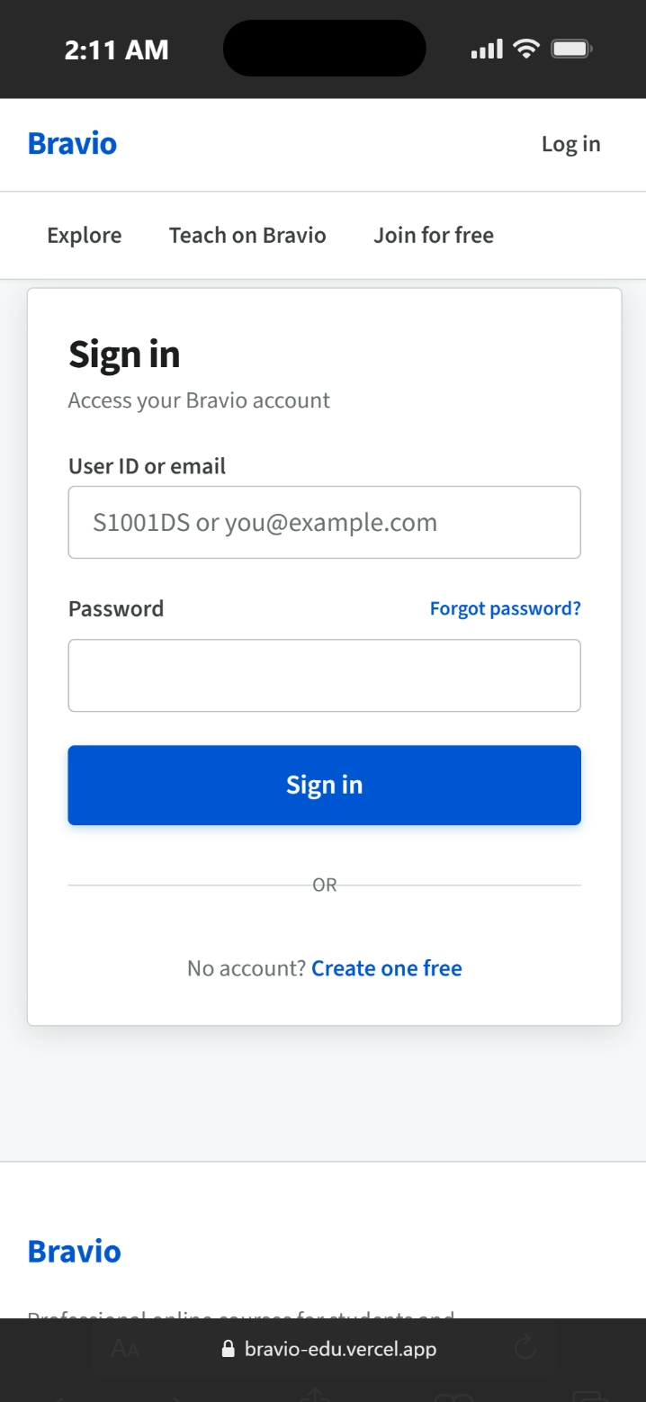
System Interfaces
Public and authentication screens, shown on a mobile browser
Landing page
Course catalogue
Registration
Sign in
Public entry point
Search and category filter
Password policy enforced
User ID or email
The same responsive interface serves desktop and mobile browsers. Sign-in accepts a user ID or an email address, and the registration form enforces the password rules before an account is created.
E-Learning Platform Project Defence
9
Notes:
These are the public screens a visitor meets first: the landing page, the course catalogue with search and category filter, the registration form and the sign-in screen. Point out two things if asked. First, the interface is responsive, so the same pages work on a phone without a separate mobile app, which is non-functional requirement NFR-04. Second, the registration form shows the password rules being enforced at the point of entry, and sign-in accepts either the generated user ID or an email address.

Slide 10
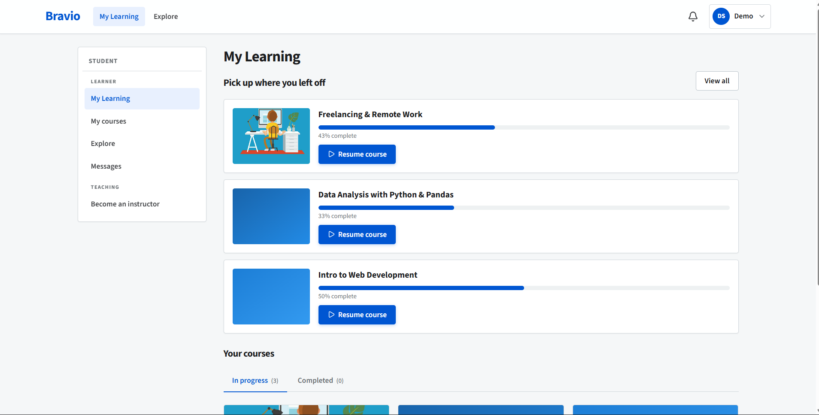
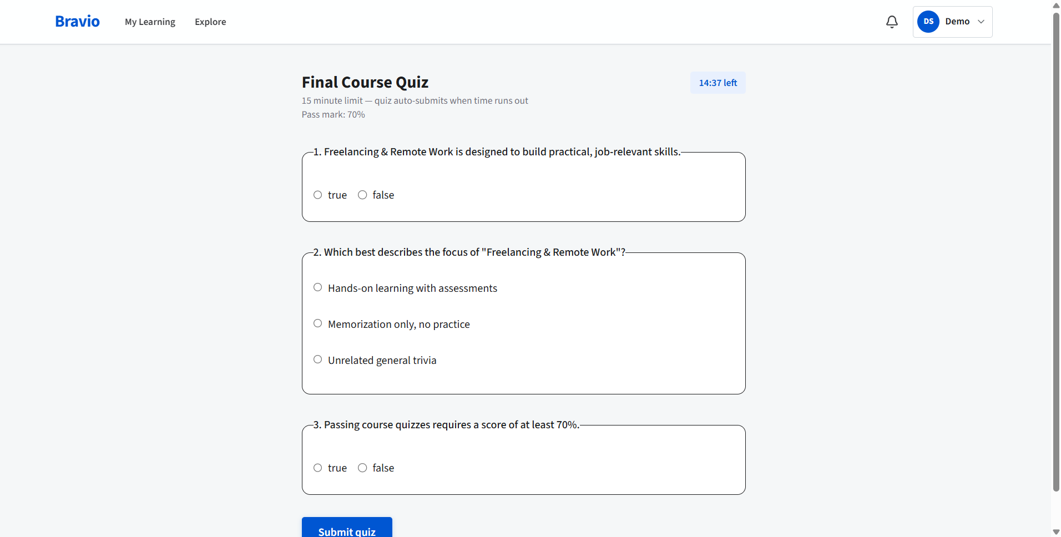
Student Learning Experience
Course progress and timed automatic assessment
Timed quiz: automatic marking and pass score
Student dashboard: enrolled courses and progress
Lesson completion and passed quizzes combine to calculate course progress.
The learner can resume from the last incomplete lesson.
Quiz answers are graded automatically and stored as an attempt history.
E-Learning Platform Project Defence
10
Notes:
This is the primary student journey: enrol, learn, complete lessons, and take assessments. Progress is not just a visual bar: it is calculated from completed lessons and passed enabled quizzes.

Slide 11
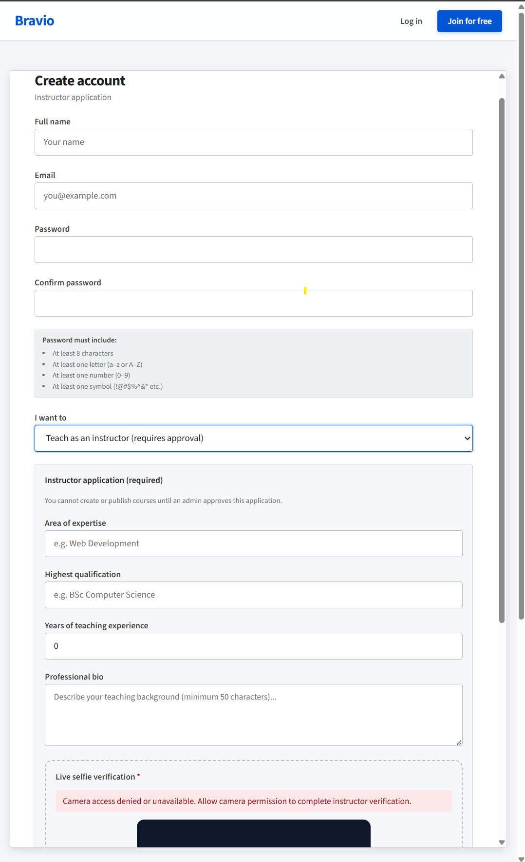
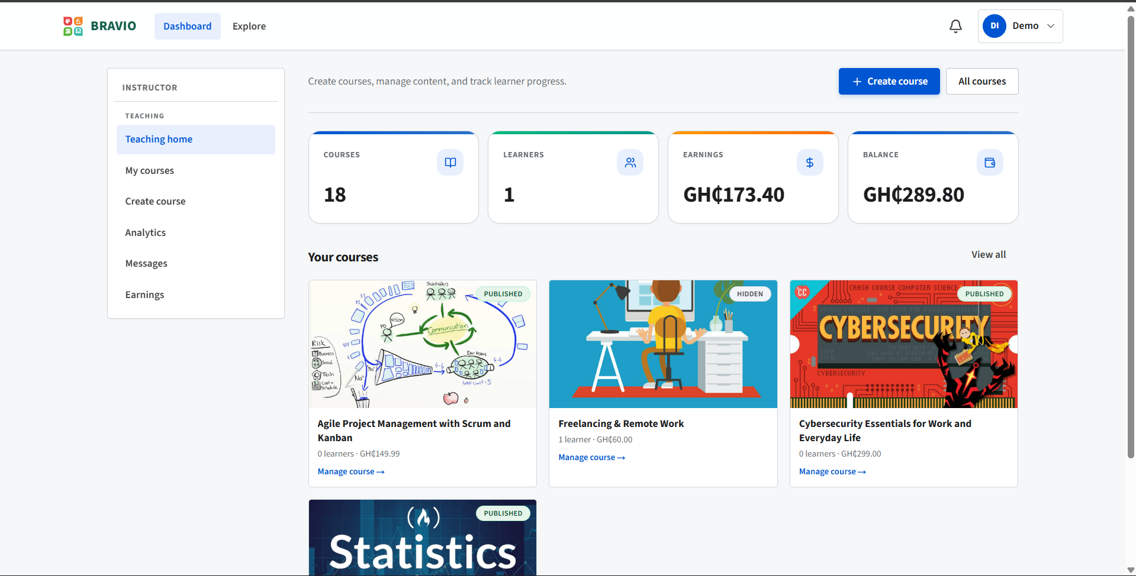
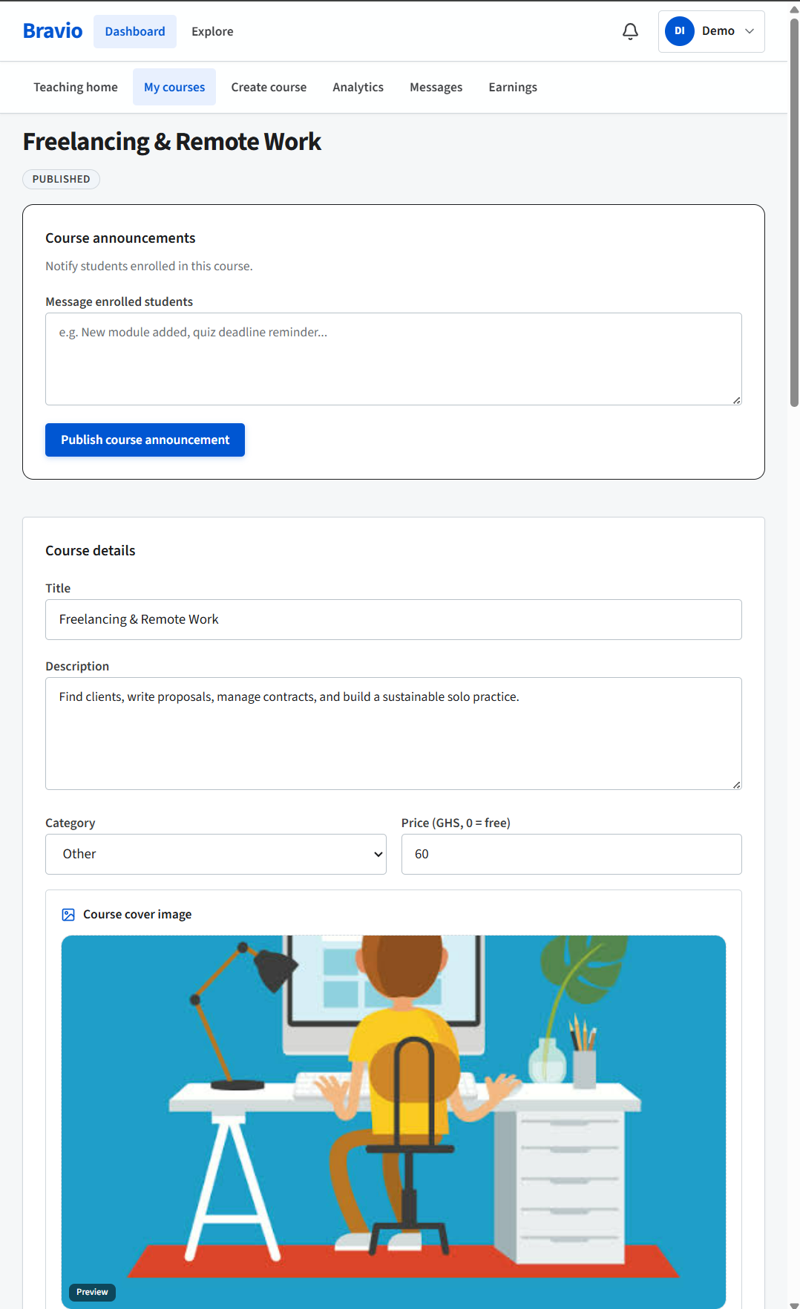
Instructor Experience
From application to course management and earnings
Instructor dashboard: courses, learners, earnings
Course editor and announcements
Instructor application and verification
Instructors cannot publish immediately. An application must be approved first, and each new course still goes through review before publication.
E-Learning Platform Project Defence
11
Notes:
The approval model balances openness with trust. An instructor application is approved first. Courses are then built as modules and lessons, and submitted separately for review.

Slide 12
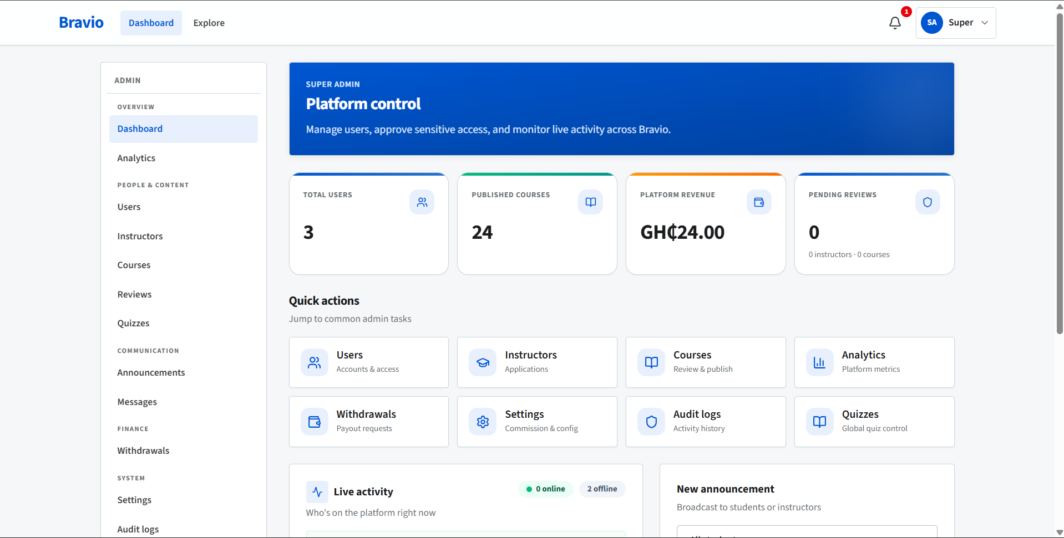
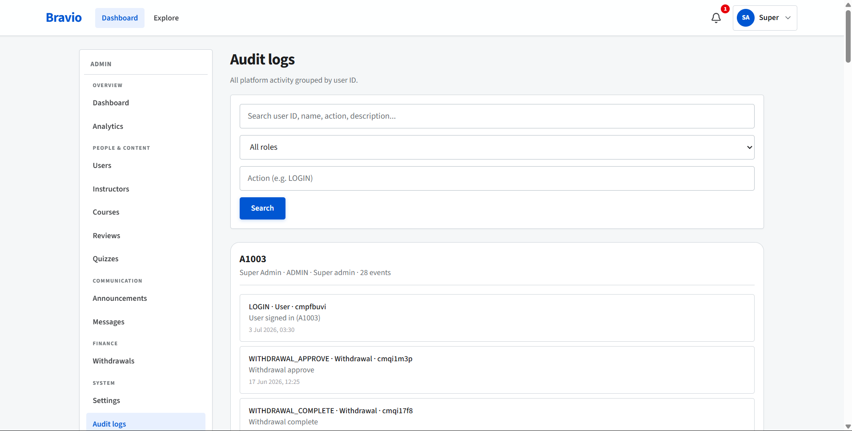
Administration and Accountability
Platform control is supported by auditability
Audit log: searchable record of sensitive actions
Admin command centre: users, courses, revenue, reviews
Manage users, instructors, courses, reviews, quizzes, announcements, withdrawals, and settings.
Approve or reject applications and courses before they are visible to students.
Use audit records to investigate actions such as logins, withdrawals, and administrative changes.
E-Learning Platform Project Defence
12
Notes:
This screen demonstrates that the solution is not only a student platform. The administrator has governance controls, while sensitive actions are recorded for accountability.

Slide 13
Testing and Evaluation
Functional, integration, and user-acceptance tests
22
3
100%
mapped test cases
testing levels
listed cases passed
Area | Example verified | Result
Authentication | Weak password, suspended account, user-code login | Passed
Course workflow | Draft → pending → approved → published | Passed
Payment | Successful payment and duplicate-event handling | Passed
Assessment | Auto-grading, timer, forged token rejection | Passed
Access control | Student attempts to open admin routes | Passed
Governance | Withdrawal limits and audit logging | Passed
E-Learning Platform Project Defence
13
Notes:
Testing covered the features that must work and the actions the system must refuse. The payment duplicate-event case and the forged quiz-token case are strong evidence of the reliability and security controls.

Slide 14
Conclusion and Future Work
What was achieved and what should happen next
What the project achieved
Future work
A working, multi-role e-learning marketplace.
Controlled instructor and course approval.
Free and paid enrolment with revenue sharing.
Progress tracking and protected auto-graded quizzes.
Security controls and accountable administration.
Production payment rollout and reconciliation.
Load testing with larger user volumes.
Offline-friendly learning and a dedicated mobile app.
Richer assessment, recommendations, and analytics.
Thank you
E-Learning Platform Project Defence
14
Notes:
The project achieved its stated scope and proved the core workflows. I will now welcome your questions.

Slide 15
Thank You
I welcome your questions and comments.
The system is running and ready for a live demonstration.
E-Learning Platform Project Defence
15
Notes:
Close by thanking the panel, then offer the live demonstration. Suggested demo order: public catalogue, student learning and a quiz attempt, instructor course creation, then the admin approval screen and audit log. Have the demo accounts already signed in on separate browser tabs, and keep the backup screenshots or recording ready in case the network fails.

